Slide 1
Ancient Greece

Slide 2
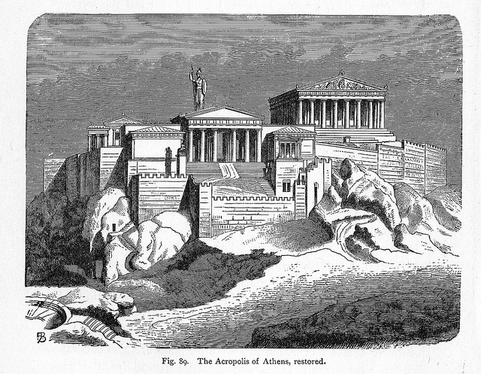
Greek gods
Worshiped many gods but valued humanity
Gods were idealized but looked like humans and had human weaknesses
Emphasis on the individual led Greeks to practice democracy

Slide 3
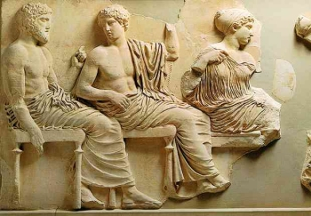
Ancient Greece
Democracy- rule by the people- but did not give equal rights to women or slaves
Advances in philosophy, math, sciences continue to influence

Slide 4
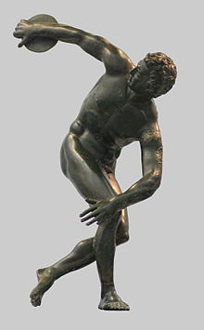
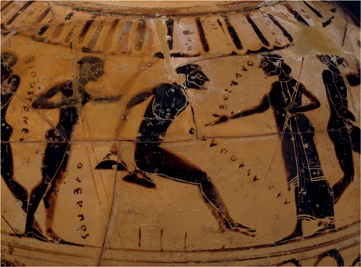
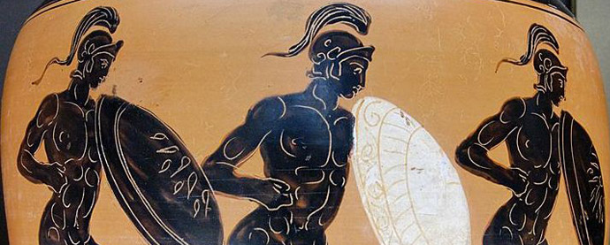
Ancient Greece
Athleticism important- Greeks held sporting contests
Origin of modern Olympic games- individuals compete for glory or money
Male sculptures were usually nude and showed idealized proportions

Slide 5
Ancient Greece
Idealized humans form- represents high intellectual and moral goals
Architecture- based on math/proportion, similar for human form
Greeks pride in physical and intellectual achievements evident in art

Slide 6
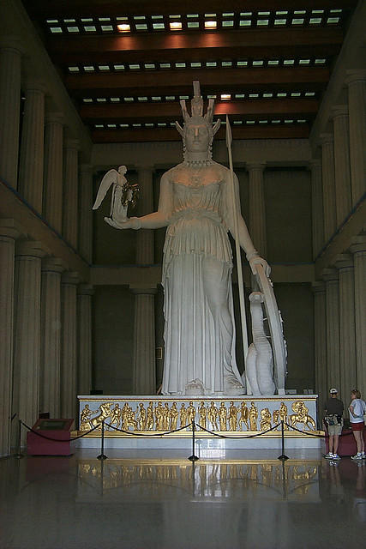
Ancient Greece
Each city- own government, protected by own god
Each had Acropolis- complex on highest point, both fortress and religious center- dedicated to patron deity of city
Athens has best known acropolis
Dedicated to goddess Athena – goddess war, wisdom and the arts
City won by goddess in competition with Poseidon god of the sea

Slide 7
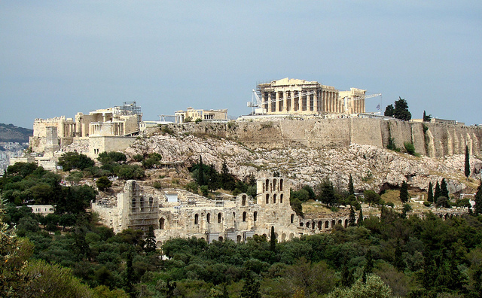
Acropolis at Athens
Parthenon
Main temple to Athena and a Treasury
Acropolis at Athens

Slide 8
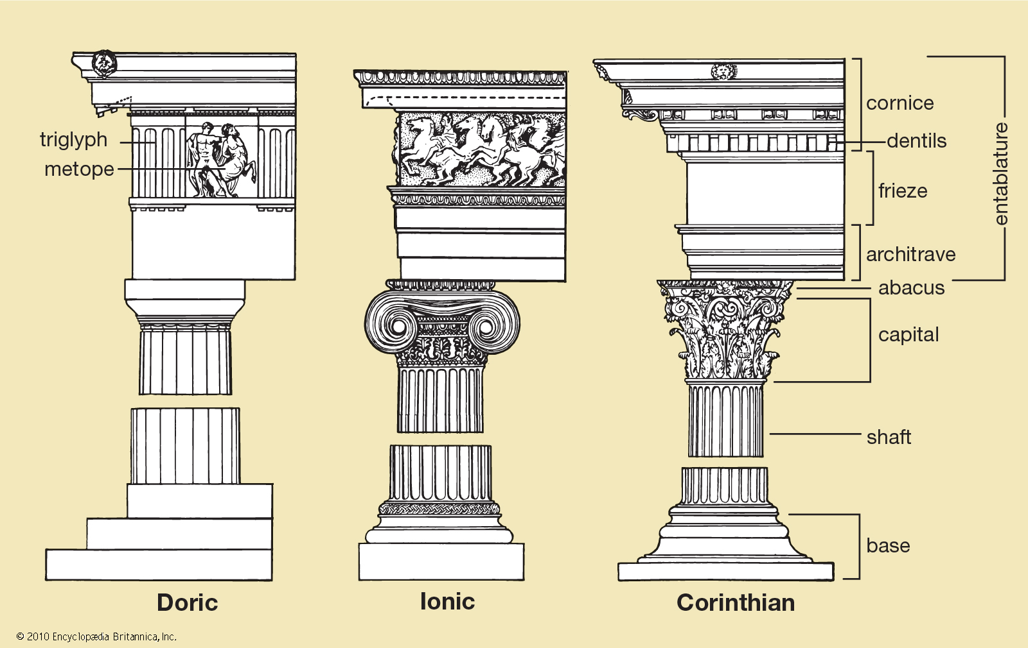
Greek Orders
Greeks developed three types of architectural designs called orders; Doric, Ionic, Corinthian
Elements of Greek design used in government buildings throughout the USA

Slide 9
Greek Relief
Relief sculptures are usually found in the frieze of Ionic buildings
Frieze – band of relief sculptures on structure
Fragment from the Parthenon

Slide 10
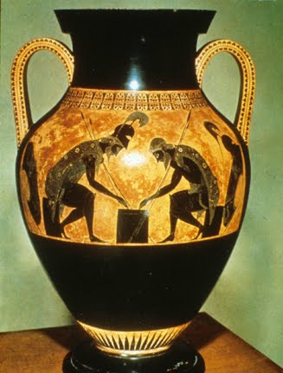
Greek Vases
Beautiful vases that show figures
Often in silhouette but sometimes showing depth
The vase to the right shows Achilles and Ajax playing dice

Slide 11
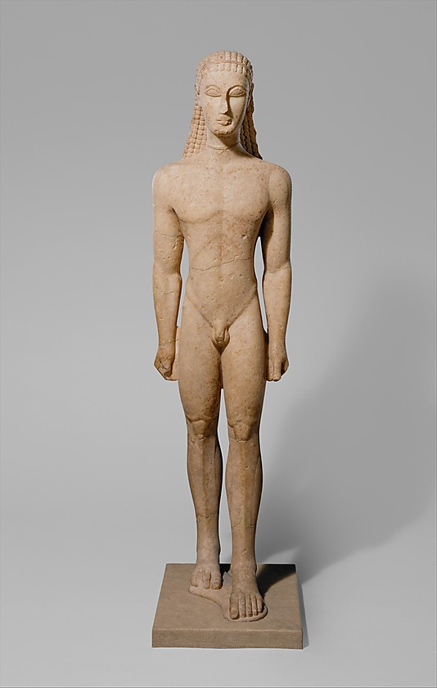
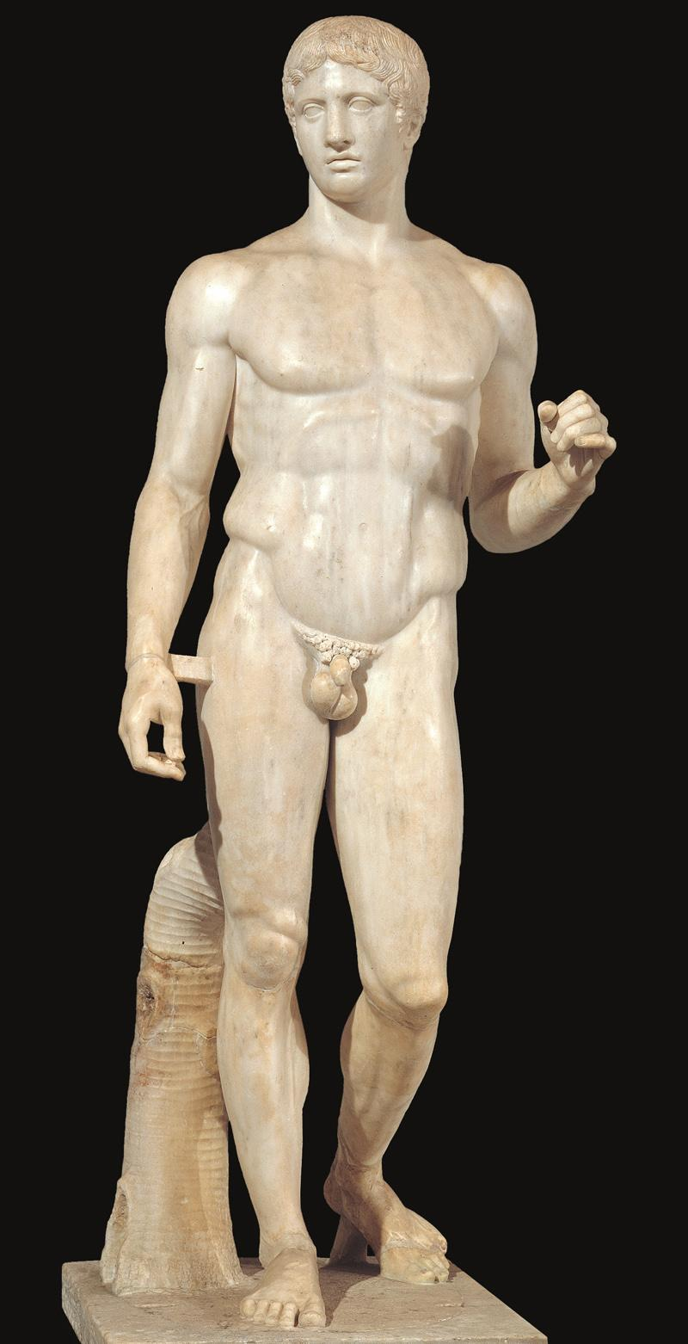
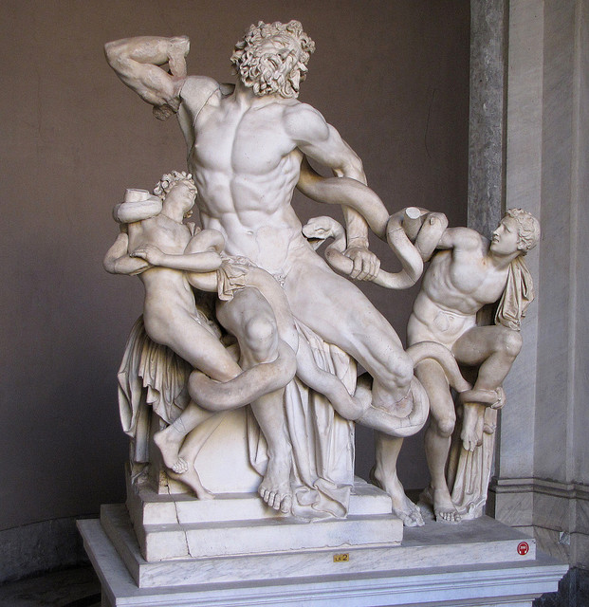
Greek Sculpture
Three main periods- Archaic, Classical and Hellenistic
Archaic- Kouros
Classical – Doryphoros of Polykleitos
Hellenistic- Lacoon and His Sons

Slide 12
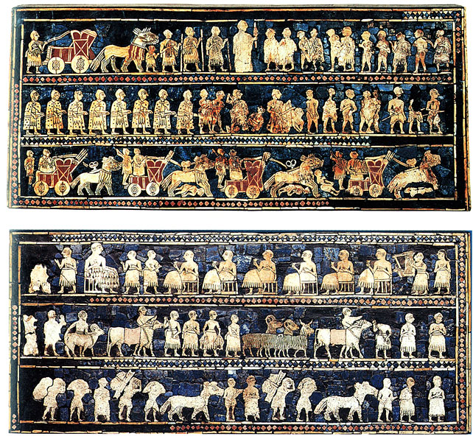
Registers
Registers- bands of images that tell a story
Narrative- artwork that tells a story

